Slide 1

BMS INSTITUTE OF TECHNOLOGY & MANAGEMENT
BENGALURU
Technical Seminar On
“ME-TLS SECURITY FOR IOT SYSTEMS”
DEPARTMENT OF CSE
Presented by:
A NITYA DYUTHI
1BY18CS001
Department of CSE
Under the guidance of:
Mrs Durga Bhavani A
Assistant Professor
Department of CSE

Slide 2
CONTENTS
CONTENTS
ABSTRACT
INTRODUCTION
LITERATURE REVIEW
METHODOLOGY
WORKING PRINCIPLE
RESULTS
CONCLUSION
REFERENCES

Slide 3
CONTENTS
ABSTRACT
This research digs deep into a new TLS-based security method, the ME-TLS, or middlebox-enhanced TLS, which enables endpoints to introduce authenticated middleboxes into a TLS session
IoT systems are widely used in our world and have turned into an indispensable technology
In-network middleboxes -> for IoT system security
But TLS blinds application-level middleboxes due to the encryption of traffic data. Many solutions have been proposed to date ->
SplitTLS: adopted in the industry by proxy manufacturers. Requires TLS client to install custom root certificates and incurs additional security flaws, e.g., disabling server authentication and using weak cipher suites
Customisation of TLS where middleboxes are enabled via either:
performing handshake directly with TLS endpoints,
receiving session key materials in an out-of-band manner
Current solutions would either jeopardise the original TLS handshake procedure or incur additional overheads on the endpoints

Slide 4
CONTENTS
Introduction
IoT -> massive group of devices connected over wired or wireless networks
A challenge to find lightweight security models and techniques as the IoT devices have low resources and low computing power
IoT devices -> a target of cyber-attacks because of deficiencies in the safety mechanism
In addition to their vulnerabilities, these devices do not have software routines for automatic updating -> use unencrypted or poorly encrypted communication channels. More smart devices (telephones, network devices, surveillance cameras or refrigerators) are involved in large scale cyber-attacks. The main cyber threats to IoT ->
DDoS attacks
Botnets
Malware attacks
Data breaches, etc.
The threat of attacks -> data manipulation to action control, which means these attacks transcend from the digital to the physical world
TLS is a cryptographic protocol designed to provide communications security over a computer network. Uses “certificates”, that consist of a key pair -> a public key and a private key. Keys -> important because they interact behind the scenes during website transactions
Role of Middleboxes

Slide 5
Literature Review
Technique | SplitTLS | Multi-Context TLS (mcTLS) | Middlebox TLS (mbTLS) | Middlebox-aware TLS (maTLS)
About | Used by proxy vendors to introduce client-side middleboxes. It needs the installation of a customized root certificate on the client, the middlebox splits the original connection into two [13] | Multi-context TLS (mcTLS)[14] endpoints to perform handshaking with each introduced middlebox. multi-context TLS enables endpoints to have fine-grained access control over the introduced middleboxes. | Middlebox TLS (mbTLS) [15] enables the endpoints to introduce middleboxes into a session on each side independently | In middlebox-aware TLS (maTLS) [16], every two adjacent neighbors establish a TLS connection called a TLS segment
Drawbacks | 1. The client is no longer able to authenticate the server 2. Middlebox vendors usually implement TLS improperly. The middlebox may create a less secure connection with the server using a weaker cipher 3. Middlebox may inject content such as advertisements into TLS traffic without client consent | Can not interoperate with standard TLS endpoints [14] and thus is not immediately deployable | During handshaking, each endpoint transmits key materials to middleboxes through secondary TLS connections [15], which will incur additional overheads on the endpoints | The middlebox certificates and TLS segments’ security information are sent to the maTLS client for assessment, thus incurring additional computation and communication overheads

Slide 6
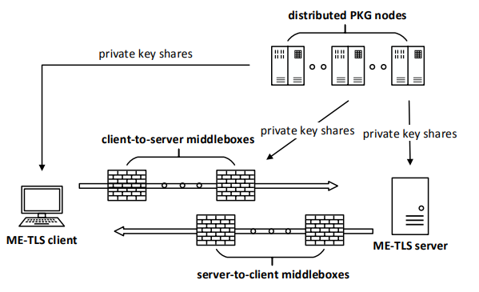
CONTENTS
Methodology and Working Principle
The system architecture:

Slide 7
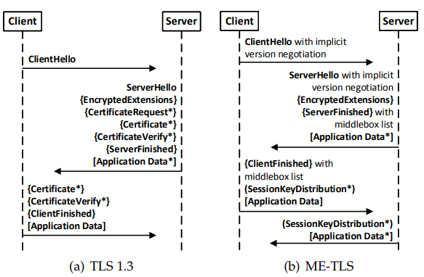
Methodology and Working Principle
TLS 1.3 and ME-TLS Handshake Overview
Points of difference:
Implicit version negotiation mechanism in handshake messages
Removal of certificate-related messages
Middlebox negotiation and endpoint authentication
Newly introduced SessionKeyDistribution message - to keep communication in-band

Slide 8
CONTENTS
Methodology and Working Principle
There are 3 types of entities in the architecture:
ME-TLS endpoint: ME-TLS client and server. Each node -> associated with a unique publicly known identity ID -> generated from IP address + metadata. At initialization, it authenticates and obtains its private key.
Middleboxes: Each middlebox has unique publicly known identity. At initialization, each middlebox also authenticates itself to the distributed PKG nodes and obtains its private key. During handshaking, ME-TLS endpoints can choose middleboxes by their identities and involve them in a session for performance and security enhancements
Distributed PKG nodes: In ME-TLS, endpoints authenticate each other and the introduced middleboxes by utilizing the BF-IBE scheme. At initialization, each ME-TLS endpoint and middlebox authenticates itself to the distributed PKG nodes
After the handshake -> middleboxes utilise session key material to inspect traffic for viruses and any malicious or irrelevant content. When a middlebox finishes processing a ME-TLS application data record, it generates a unique hop-tag and updates the field in the record.

Slide 9
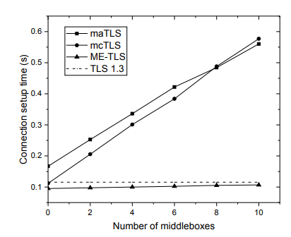
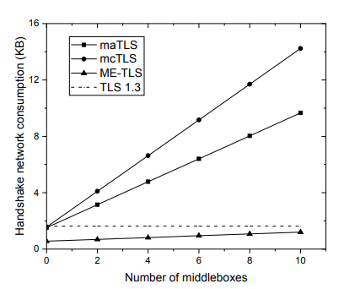
Results

Slide 10
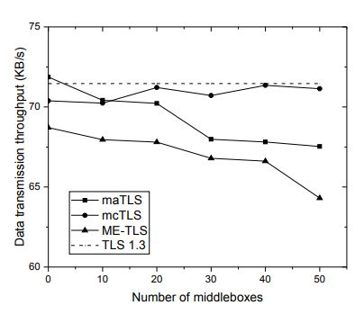
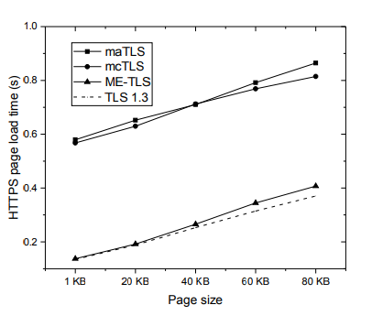
Results

Slide 11
CONTENTS
Conclusion
Security is of prime importance in IoT systems. IoT systems carry and process highly sensitive data that needs to remain air tight, as they have ramifications in the real, physical world. In this research, we have considered a more hardware oriented approach, the middleboxes, since IoT devices are low on computing resources.
The ME-TLS protocol is designed and implemented, which aims to introduce middleboxes into TLS sessions in a passive, authenticated manner. ME-TLS endpoints can further perform traffic access control and service chain verification over the introduced middleboxes. An implicit version negotiation mechanism is also provided to enable legacy TLS compatibility. Distributed BF-IBE infrastructure is introduced into ME-TLS to perform entity authentication and session key distribution, which eliminates the problems with PKI.
Finally, various performance evaluations are run on the proposal, the experimental results show that ME-TLS offers promising performances and is suitable for practical deployment in IoT systems.

Slide 12
REFERENCES
[1] 2020 Yifeng Zheng; Arindam Pal; Sharif Abuadbba; Shiva Raj Pokhrel; Surya Nepal; Helge Janicke “Towards IoT Security Automation and Orchestration”
[2] 2017 Mengmeng Ge, Jin B. Hong, Walter Guttmann, Dong Seong Kim “A framework for automating security analysis of the internet of things”
[3] 2015 Kashif Habib, Wolfgang Leister “Threats Identification for the Smart Internet of Things in eHealth and Adaptive Security Countermeasures”
[4] 2020 Jie Li; Rongmao Chen; Jinshu Su; Xinyi Huang; Xiaofeng Wang “ME-TLS: Middlebox-Enhanced TLS for Internet-of-Things Devices”
[5] 2020 Stephen Hilt, Fernando Mercês, Mayra Rosario, and David Sancho “Worm War: The Botnet Battle for IoT Territory”
[6] 2021 Muhammad Talha Paracha, Narseo Vallina-Rodriguez, Daniel J. Dubois, David Choffnes “IoTLS: Understanding TLS Usage in Consumer IoT Devices”
[7] 2018 “Rfc 8446 - the transport layer security (TLS) protocol version 1.3”
[8] 2019 EtherealMind.com, “Percentage of https (TLS) encrypted traffic on the internet?”
[9] 2000 “RFC 2818 - HTTP over TLS”
[10] 2016 S. A. Shinde, P. A. Nimkar, S. P. Singh, V. D. Salpe, and Y. R. Jadhav, “Mqtt-message queuing telemetry transport protocol,” International Journal of Research, vol. 3, no. 3, pp. 240–244, 2016.
[11] 2011 P. Saint-Andre, “Extensible Messaging and presence protocol (XMPP): Core,”.
[12] S. Vinoski, “Advanced message queuing protocol,” IEEE Internet Computing, no. 6, pp. 87–89, 2006.
[13] T. Chung, D. Choffnes, and A. Mislove, “Tunnelling for transparency: A large-scale analysis of end-to-end violations on the internet,” in Proceedings of the 2016 Internet Measurement Conference. ACM, 2016, pp. 199–213.
[14] D. Naylor, K. Schomp, M. Varvello, I. Leontiadis, J. Blackburn, D. R. Lopez, K. Papagiannaki, P. Rodriguez Rodriguez, ´ and P. Steenkiste, “Multi-context TLS (mcTLS): Enabling secure in-network functionality in TLS,” ACM SIGCOMM Computer Communication Review, vol. 45, no. 4, pp. 199–212, 2015.
[15] D. Naylor, R. Li, C. Gkantsidis, T. Karagiannis, and P. Steenkiste, “And then there were more: Secure communication for more than two parties,” in Proceedings of the 13th International Conference on emerging Networking EXperiments and Technologies. ACM, 2017, pp. 88–100
[16] H. Lee, Z. Smith, J. Lim, G. Choi, S. Chun, T. Chung, and T. T. Kwon, “maTLS: How to make TLS middlebox-aware?” in NDSS, 2019.

Slide 13
THANK YOU

